Slide 1
Google professional Certificate
Cybersecurity
Applicant’s Guide
A training program to become a
Cybersecurity Analyst
Start Date:
01/04
Duration:
16 Weeks part-time
or 8 weeks full time
(170h)
Format:
Online
Price:
Free
Eligibility
18-35 year old
Obstacles to employment

Slide 2
The program: Technical training
This Google Career Certificate program delivered by INCO will teach you not only the necessary languages and technologies, but the mindset and soft skills to thrive in your new job. By the end, you’ll have the well-rounded skills needed to thrive in in-demand roles and you’ll be able to present your Google + INCO Academy certifications to employers.
The two pillars of this program are technical and employability skills. On top of these trainings, you will meet Cybersecurity professionals to learn more about the sector.
8 technical courses covering the main Cybersecurity domains
Foundations of Cybersecurity
Play It Safe: Manage Security Risks
Connect and Protect: Networks and Network Security
Tools of the Trade: Linux and SQL
Assets, Threats, and Vulnerabilities
Sound the Alarm: Detection and Response
Automate Cybersecurity Tasks with Python
Put It to Work: Prepare for Cyber Security Jobs
Cybersecurity analysts use analytical and technical skills to crack cyber puzzles each day, With so much riding on the safety of organizations' data, they can be the heroes that save the day.
By the end of the program, you will :
Understand the importance of cybersecurity practices and their impact for organizations.
Identify common risks, threats, and vulnerabilities, as well as techniques to mitigate them.
Protect networks, devices, people, and data from unauthorized access and cyberattacks using Security Information and Event Management (SIEM) tools including Chronicle and Splunk, and Intrusion Detection Systems (IDS) including Suricata.
Gain hands-on experience with Python, Linux, and SQL

Slide 3
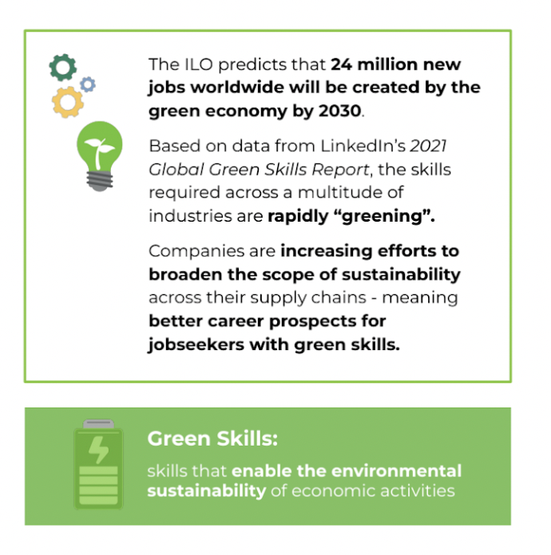
The program: Green Digital Skills
Take your next step toward a greener, digital career with confidence.
The INCO Academy UK programs include access to training in Green Digital Skills for all their Career Certificate learners. By the end of the program, you’ll have in-demand skills to help further advance your digital career for a greener future.
Gain the necessary knowledge and practices, to think with sustainability and green design in mind.
Understand how digital technology impacts climate change
Recognize specific ways to reduce the environmental impact of the digital ecosystem
Discuss technology and its related innovations as tools for sustainability

Slide 4
The program: Job Readiness
Our Professional Skills Program focuses on personal & professional growth.
Improve your employability with personal and professional development to land your target job.
Gain employability skills with dedicated resources on INCO’s Professional Skills Platform & access our mentoring events
Successfully apply for a job in the Data Analytics Sector
Learn how to write a winning Data Analyst relevant CV
Develop a successful LinkedIn profile to get you noticed
Use your Capstone project to go from Zero to Hero by demonstrating your new data skills, tools & competencies to get you hired
Greater Understanding of the local job market
Career Mapping & Signposting support
Recognise the value of your transferable skills & overcome the Impostor Syndrome
Embody the Power of Networking
Job interview Preparation - focus on both technical, behavioural aptitudes and participate in mock interviews
INCO Academy LinkedIn Alumni Support
Keep up to date with industry news, events and positions
Network with peers, supportive organisations and recruiters
Find out about mentoring events & career development sessions
Reach your professional future goals
85-90% of recruiters use LinkedIn to search for candidates
96% of recruiters use LinkedIn in their hiring processes
Notes:
Professional Skiills Program

Slide 5
Eligibility & Application
You are
resident in xxxx
You are
between 18 and 35 years old
You are looking for a way to kick start your career
PREREQUISITES
You don’t need to have a previous degree.
You don’t need to have previous experience in DA or Tech knowledge.
You have to demonstrate a strong motivation. It is an intensive program, content-rich, which will require for you to be an actor of your success.
LANGUAGE
You have to understand and speak English in a way that allows you to follow the program (B1 is the minimum level recommended). Our training team can support you but you need to be autonomous with the program content most of the time.
EQUIPMENT
You have to have access to a computer or a tablet (ideally a personal computer) and an Internet connection. If you don’t, please contact us to see if we can arrange an alternative solution.
HOW TO APPLY?
Onboarding
Fill an Application form
Follow up with member of IA team
Attend an Information session
Admission & Coursera registration

Slide 6
What you will get
As part of the program, we provide wrap-around services to support learners from the beginning to the end of the sessions and their certification.
Before the program
You get support through application and enrollment
You get onboarded on the Coursera platform, program tools and communication channels
During the program
You will have access dedicated expert coach to support you as you progress through the program
You will benefit from practical assignments sessions to practice the skills you learn
You will have access to study groups and communication channels to enhance your journey and progress together with other learners
You get access to relevant resources on Data Analysis curated for you
You get troubleshooting support
You get to meet DA professionals and industry experts
After the program
You will have access to career counseling, mentoring and job placement services
You integrate into INCO Academy’s community
As cyber-related threats continue to grow and evolve rapidly, organizations now view cybersecurity as a must-have. Because of this, cybersecurity analysts are in high demand and can command a competitive salary across a wide range of industries.
cybersecurity analyst,
security analyst,
security operations center (SOC) analyst,
information security analyst,
IT security analyst,
Cyber defense analyst

Slide 7
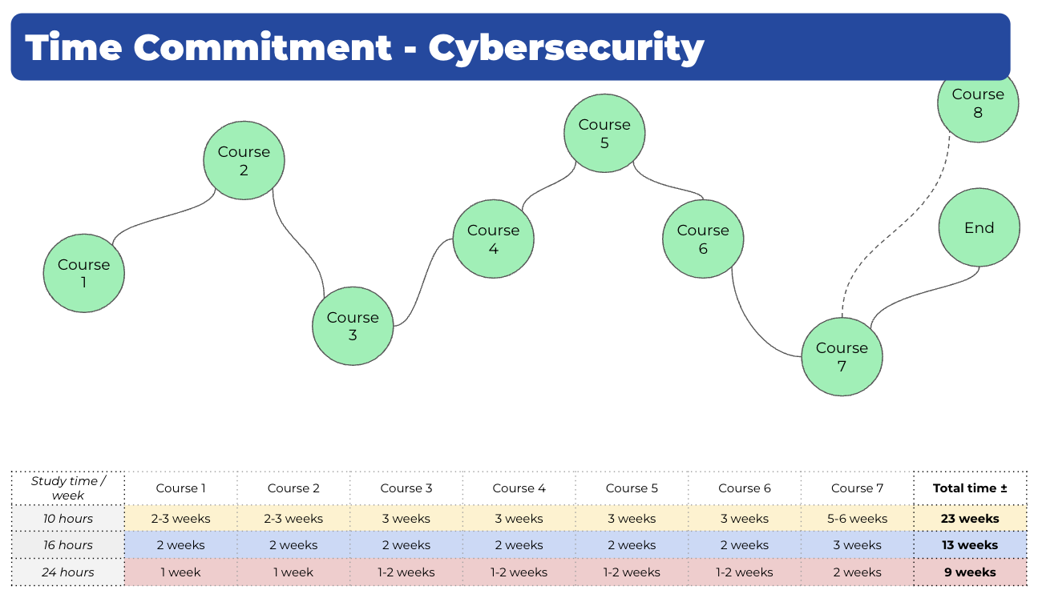
What to expect
The program is designed to create a supporting environment but also leave some room for a rhythm that suits you. The program combines individual work with collective sessions and workshops.
Self-paced program
Convenient: You can work the program into your schedule wherever it works best.
Effective: Helps improve memory performance,
as you can allocate more time to the more
difficult material.
Efficient: You can make the best use of your
time, in order to meet your learning objectives

Slide 8
Time commitment
The program is designed to create a supporting environment but also leave some room for a rhythm that suits you. The program combines individual work with collective sessions and workshops.
Time commitment
Course 2
Course 4
Course 6
Course 8
Course 1
Course 3
Course 5
Course 7
12h/week
16 weeks total
MAXIMUM
26h/week
8 weeks total
MAXIMUM
40h/week
4-5 weeks total
MAXIMUM
Self-paced program
Convenient: You can work the program into your schedule wherever it works best.
Effective: Helps improve memory performance,
as you can allocate more time to the more
difficult material.
Efficient: You can make the best use of your
time, in order to meet your learning objectives

Slide 9
Program format
To help you succeed, you will have access to:
Self-paced learning
Expert
sessions
Professional
skills
Google Certification Course on Coursera
Technical resources
Live technical sessions
Live practical sessions
Professional skills track to develop employability
Support
Community
Mentoring
Technical expert support
Individual follow-up 1:1
Office hours
Support from the community of learners
Possibility of working in study groups
Access to individual mentoring sessions with professionals
Communication tools
Where you will learn
Where you attend expert sessions
Where you interact with experts and fellow learners
… and many other tools

Slide 10
Certification
Dual credential
Learners who complete the whole program will have access to a double credential from Google.org and INCO Academy.
Upon completion of each of the 8 courses from the Google Data Analytics online course, you earn an individual certification of completion:
Foundations of Cybersecurity
Play It Safe: Manage Security Risks
Connect and Protect: Networks and Network Security
Tools of the Trade: Linux and SQL
Assets, Threats, and Vulnerabilities
Sound the Alarm: Detection and Response
Automate Cybersecurity Tasks with Python
Put It to Work: Prepare for Cybersecurity Jobs
Google Cybersecurity Individual Course Certifications
Google Cybersecurity
Certificate
Upon completion of the 8 course you receive the Google Data Analytics Certificate, equivalent to +170 hours of training.
INCO Academy Certificate
Upon completion of the 8 courses you will receive a Certificate from INCO Academy too
Sharable Certificates
You can share your Certificates in the Certifications section of your LinkedIn profile, on printed CVs, or other documents to catch the attention of potential employers.

Slide 11
Your INCO Academy Team
Throughout the program, our learner support team is looking after you and ensuring the proper deployment of the program.
In addition to the learner support team, the program sessions and workshops are delivered by our CS experts. All the trainers who intervene in the program are specialists of their respective field: technical skills development, CS sector expertise, professional and personal development, employability.
Cybersecurity professionals will also be invited to share their experience and provide insight into the possibilities which you can access, once you graduate and obtain your certification.
Our team
Our team
Katalin
Cybersecurity Expert
Chris
Learning Coach
Julia
Program Manager

Slide 12
Contact
Get in touch - we will come back to you within 48h (business days):
iaitalia@inco-group.co
Website
More information on our website INCO Academy
www.incoacademyitaly.com
APPLY NOW!

